Slide 1
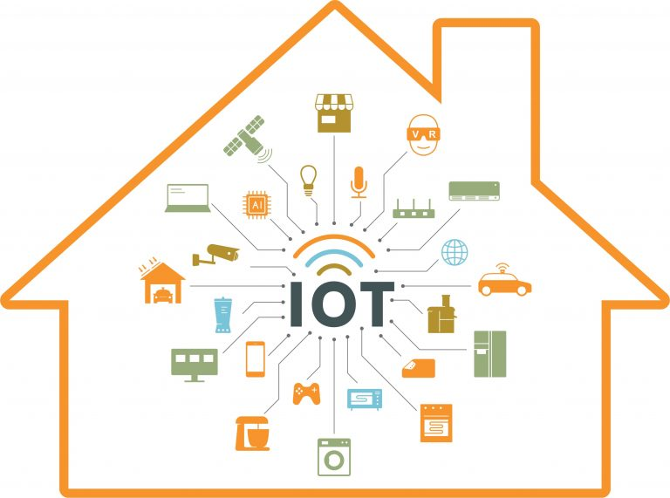
INTERNET OF THINGS
KARUN CHERY JAMES
S2 CSEA
38

Slide 2
TOPICS
What is IOT
Why IOT
How IOT works
Challenges of IOT

Slide 3

WHAT IS IOT?
The Internet of Things (IoT) is the network of physical objects or "things" embedded with electronics, software, sensors, and network connectivity, which enables these objects to collect and exchange data.
http://www.syncopathlabs.com/wp-content/uploads/2018/09/WhatIsIt-300x254.jpg

Slide 4
Why IOT?
Automation and control
Communication
Monitor
Time and Money

Slide 5
Automation and control
Without human intervention, the machines are able to communicate with each other leading to faster and timely output.
Communication
Also known as Machine-to-Machine (M2M) communication
Physical devices are able to stay connected and hence the total transparency is available with lesser inefficiencies and greater quality.

Slide 6
Monitor
Knowing the exact quantity of supplies or the air quality in your home
Time and Money
The amount of time saved because of IoT could be quite large
And in today’s modern life, we all could use more time.

Slide 7
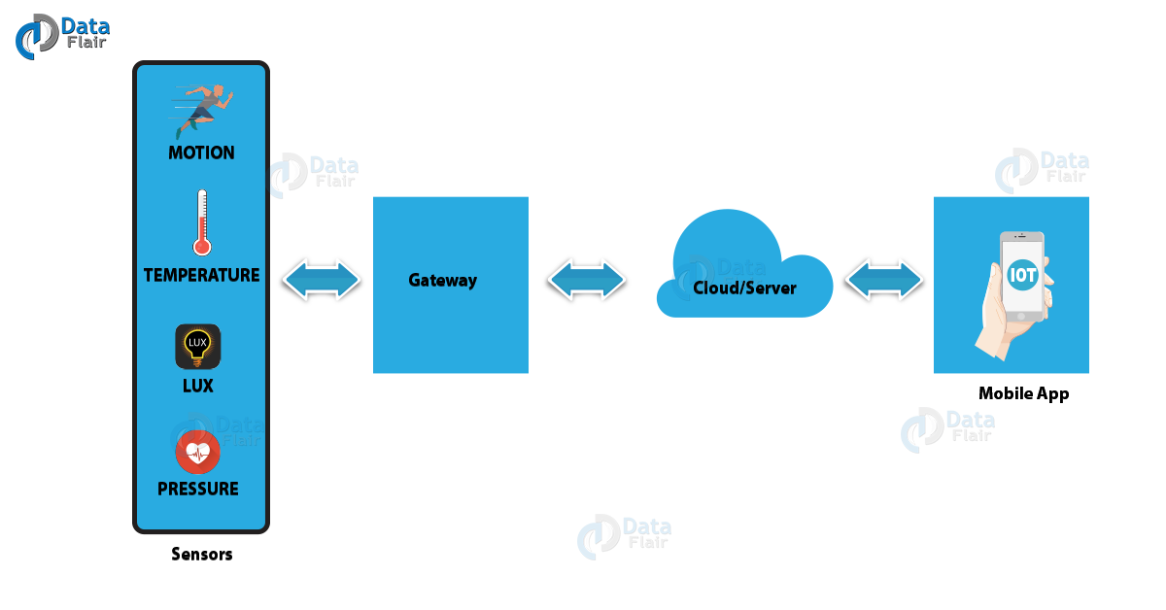
HOW IOT WORKS?
https://d2h0cx97tjks2p.cloudfront.net/blogs/wp-content/uploads/sites/2/2018/05/iot-working-image-1.png

Slide 8
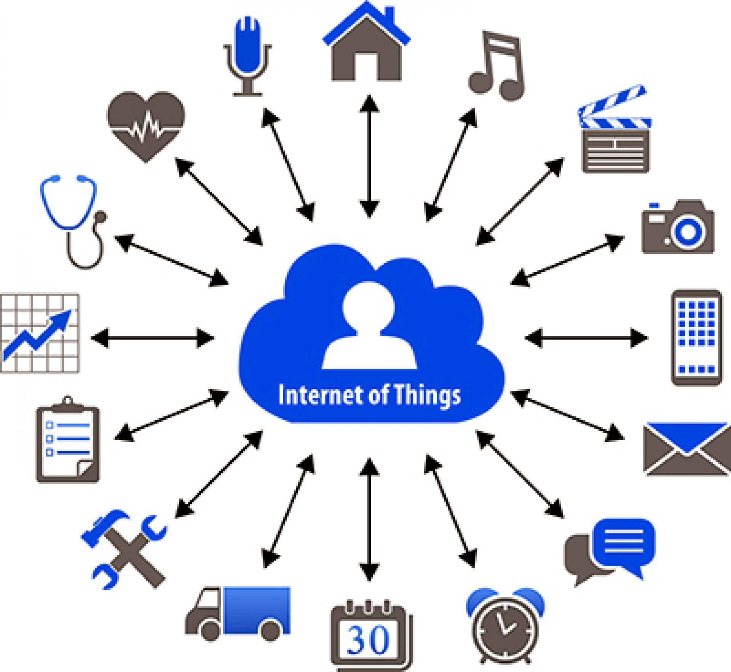
Sensors/devices
Sensors play an important role in creating solutions using IoT.
Sensors are devices that detect external information, replacing it with a signal that humans and machines can distinguish.
Temperature and humidity sensors ,Acceleration sensors ,Gyro sensors
https://d2h0cx97tjks2p.cloudfront.net/blogs/wp-content/uploads/sites/2/2018/05/iot-working-image-3.jpg

Slide 9
GATEWAY
(Iot) gateway is a physical device or software program that serves as the connection point between the cloud and controllers, sensors and intelligent devices.
A gateway provides a place to preprocess that data locally at the edge before sending it on to the cloud
Can have a big impact on response times and network transmission costs.

Slide 10
CLOUD/SERVER
The cloud is a huge, interconnected network of powerful servers that performs services for businesses and for people.
Using the cloud is important for aggregating data and drawing insights from that data
High scalability
User interface
The user interface consists of the features by which a user interacts with a computer system.

Slide 11
CHALLENGES OF IOT
SECURITY
They can simply finesse their way in through one of the many security vulnerabilities
Many IoT devices have default passwords left unchanged, unpatched software and other major security vulnerabilities.
2.BANDWIDTH
Connectivity is a bigger challenge to the IoT
Features like intelligent switching between mobile network operators (MNOs) are particularly useful for creating a more reliable and user-friendly IoT product

Slide 12
conclusion
“How much more IOT can do is only left to your imagination - Unleash Your Creativity”

Slide 13
REFERENCES
https://www.slideshare.net/
https://youtube.com/
https://www.iot-now.com/2019/07/07/97056-what-is-iot/
https://www.linkedin.com/pulse/why-we-need-iot-internet-things-jugeshwar-mahto#:~:text=IoT%20wants%20to%20connect%20all,we%20can%20use%20it%20whenever.

Slide 14
THANK YOU

